Slide 1
Climate and Development
Recap of distribution of impacts
Dynamic vulnerability
Schelling Conjecture
Climate and growth
Climate and development

Slide 2
Lectures
Science
Scenarios & emission reduction options
Costs of emission reduction
Instruments for emission reduction
Impacts of climate change & adaptation
Economic impacts of climate change
Climate and development
Optimal emission reduction
Discounting, uncertainty, equity
International environmental agreements

Slide 3
Climate and Development
Recap of distribution of impacts
Dynamic vulnerability
Schelling Conjecture
Climate and growth
Climate and development

Slide 5
Exposure
Limits / analogues
Adaptive capacity

Slide 6
Exposure
Limits / analogues
Adaptive capacity

Slide 7
Exposure
Limits / analogues
Adaptive capacity

Slide 8
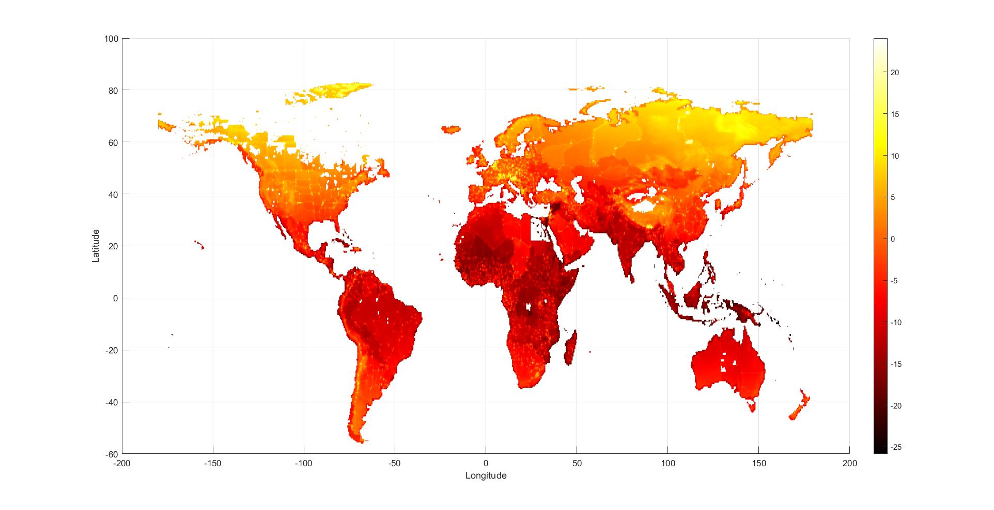

Slide 9
Climate and Development
Recap of distribution of impacts
Dynamic vulnerability
Schelling Conjecture
Climate and growth
Climate and development

Slide 10
Dynamics
Vulnerability to climate change is a function of exposure and adaptive capacity, both of which depend on development status
Future vulnerability will be very different from current vulnerability
Not only is future development uncertain, but also the link between development, exposure and adaptive capacity is unclear
I will illustrate this with the case of malaria

Slide 11
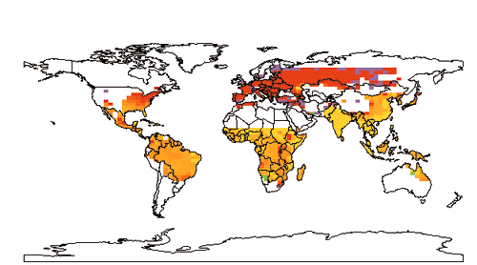


Slide 12
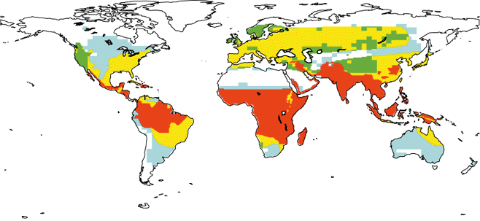


Slide 14
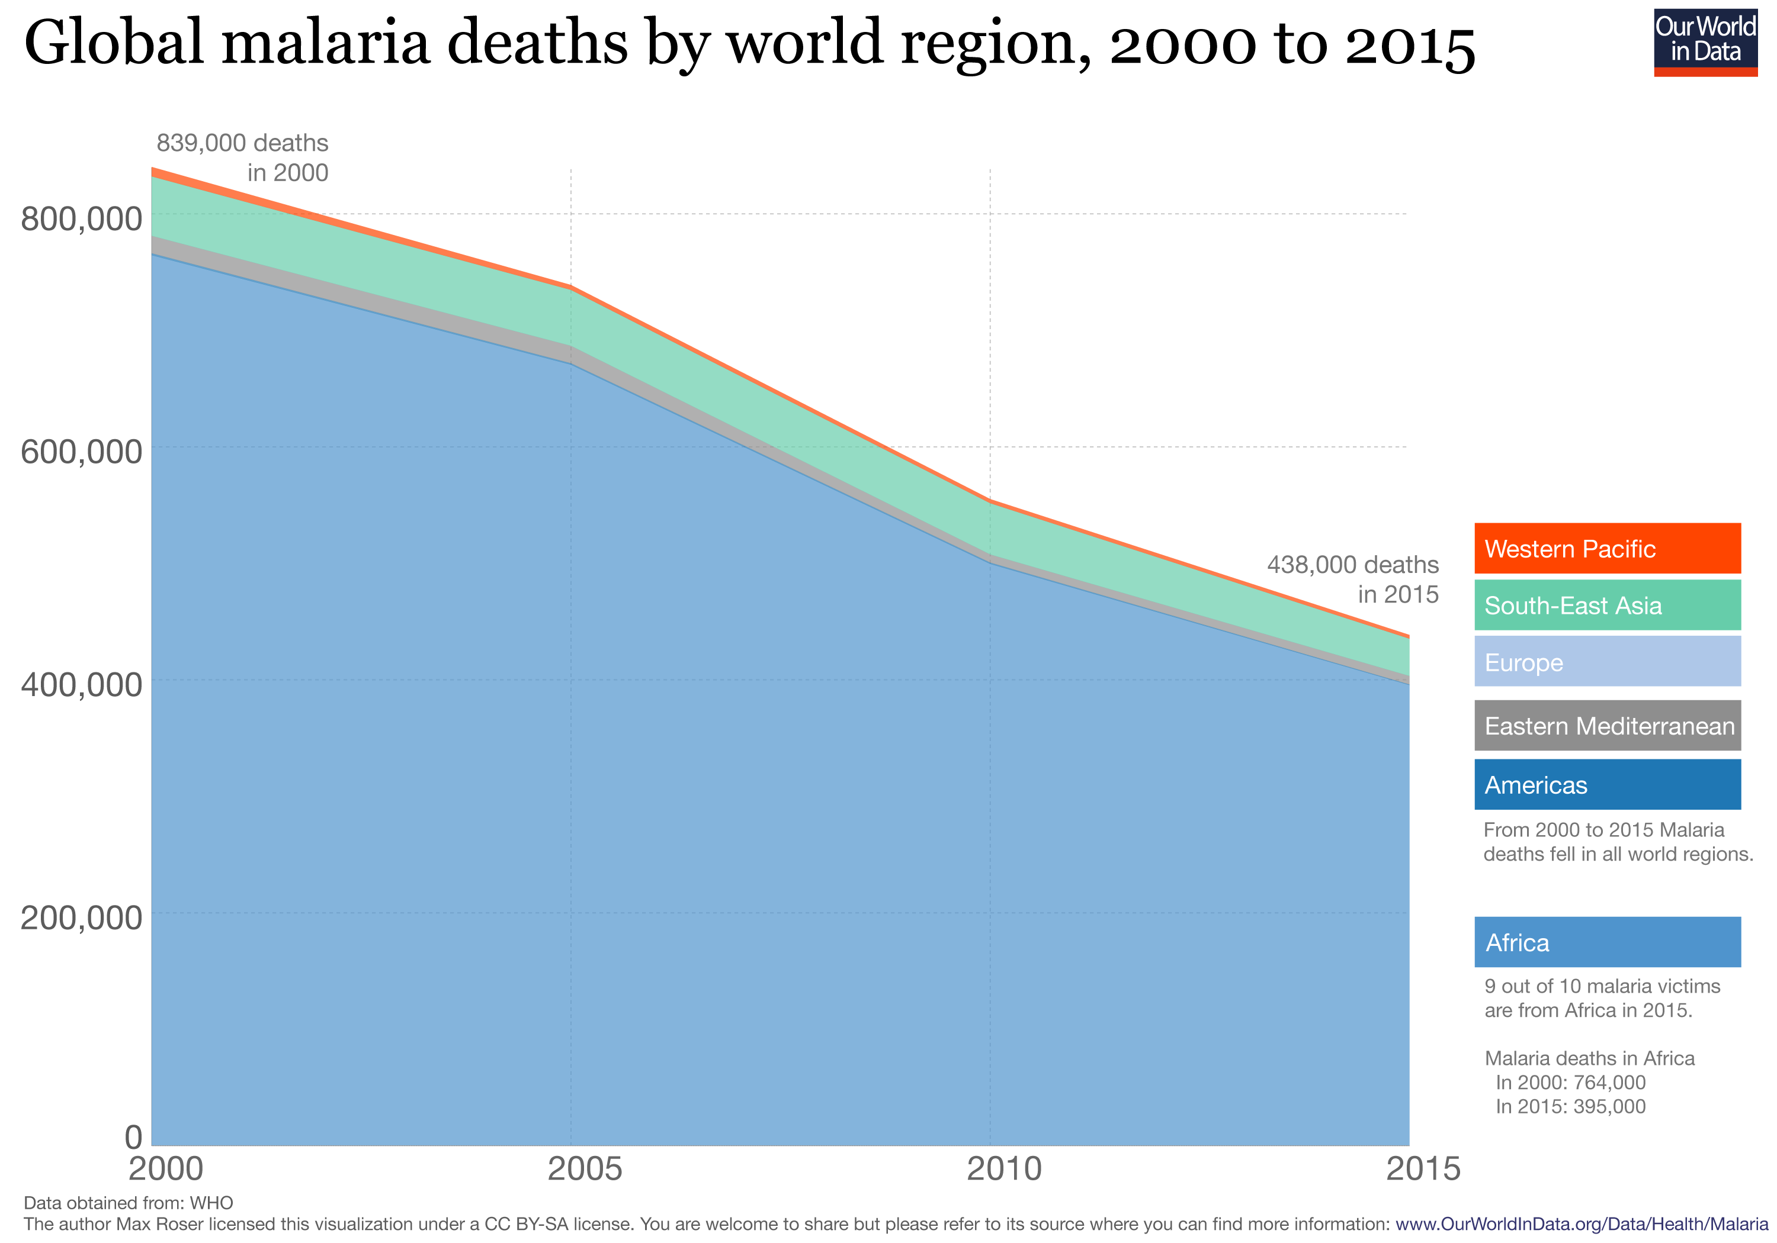

Slide 15
Climate and Development
Recap of distribution of impacts
Dynamic vulnerability
Schelling Conjecture
Climate and growth
Climate and development

Slide 16
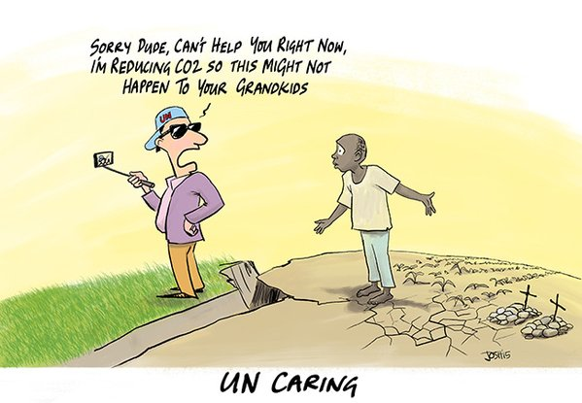
Schelling Conjecture
Nobel Laureate Tom Schelling asked
Why do we care about the grandchildren of people we do not seem to care about?

Slide 17
Schelling Conjecture
Nobel Laureate Tom Schelling asked
Why do we care about the grandchildren of people we do not seem to care about?
If we really do care about the impacts of climate change on the descendants of the current poor, are there better ways of helping them than through greenhouse gas emission reduction?
Is adaptation assistance a better way to reduce the impact of climate change?

Slide 18
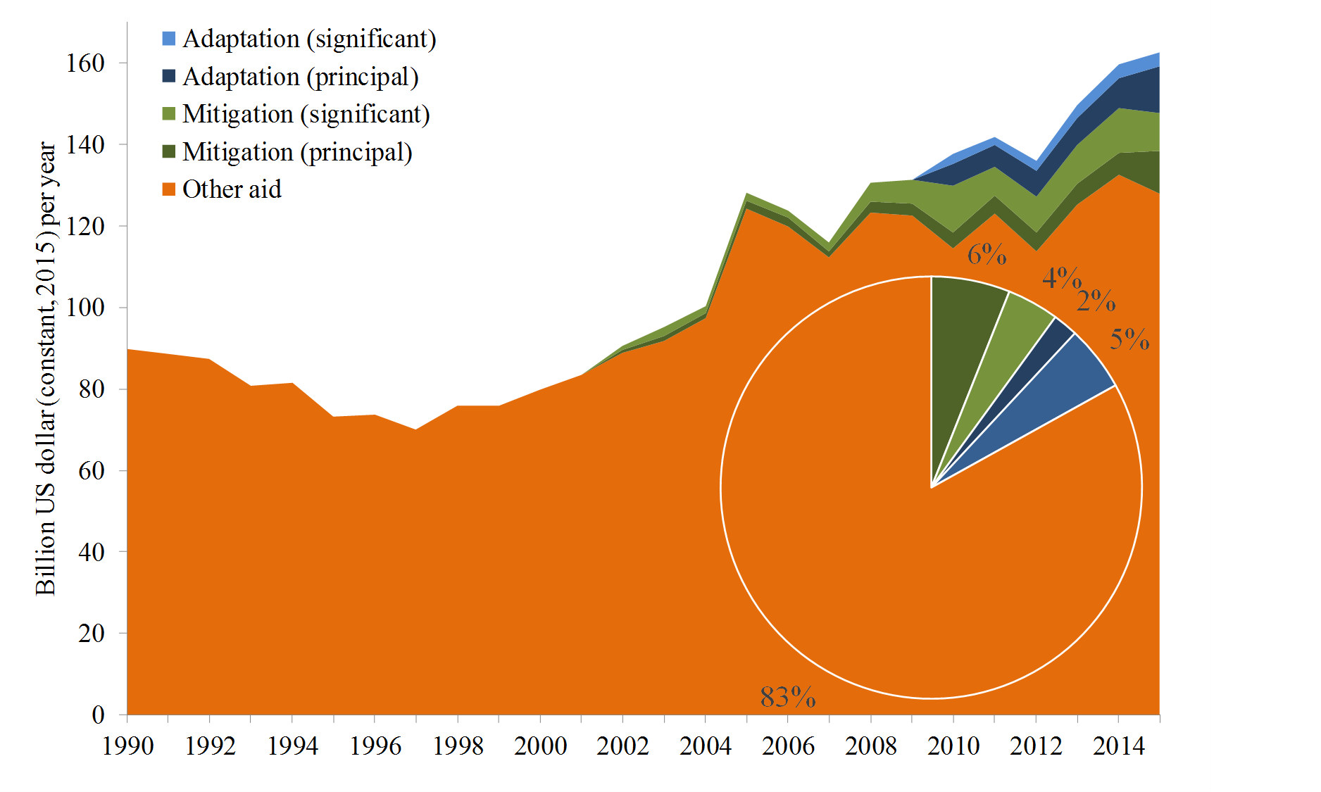

Slide 19
Schelling Conjecture -2
Is adaptation assistance a better way to reduce the impact of climate change?
Yes, if you could be sure to invent say a malaria vaccine if you invested enough, and would be sure it would use appropriately
Adaptive capacity is complex, however, and closely related to development
Development assistance has proven difficult

Slide 20
Schelling Conjecture -3
Besides, poverty implies vulnerability in general, but not always
Richer people
put higher values on health and environment
tend to live longer and thus develop cardiovascular diseases
might buy air conditioning that heats their environment

Slide 21
Climate and Development
Recap of distribution of impacts
Dynamic vulnerability
Schelling Conjecture
Climate and growth
Climate and development

Slide 22
Climate change and growth
Climate change can affect welfare through four channels
Utility (e.g., species loss)
Labour (e.g., morbidity)
Output per worker (e.g., agricultural productivity)
Depreciation (e.g., floods)
Utility: no impact
If output is lower in period t, less is consumed and less is saved, so that there is less capital and less output in period t+1
Ditto for higher depreciation

Slide 23
Climate change and growth -2
In principle, people could compensate through increased savings
Not rational as would cut consumption even more
Besides, the returns to capital have fallen
If the labour force shrinks, there is more capital per worker, higher labour productivity, higher wages
The rational response is to consume the windfall, save less, until the capital-labour ratio is back at its desired value
Effect is small as the health impacts of climate change primarily fall on the non-working population

Slide 24
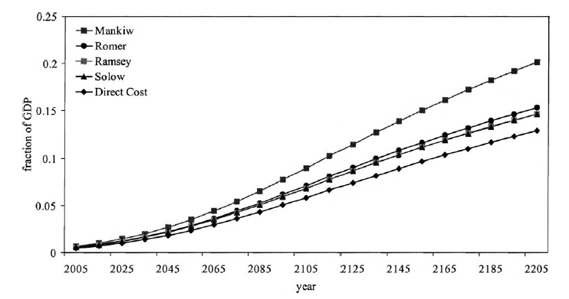

Slide 25
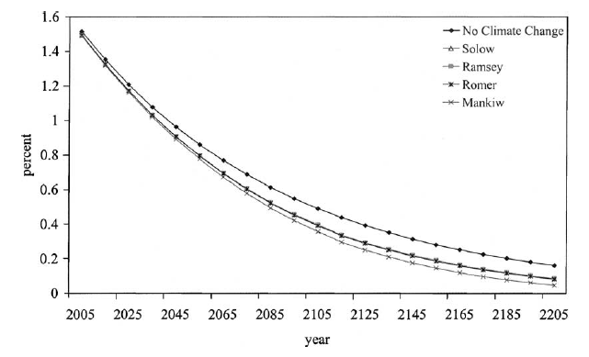

Slide 26
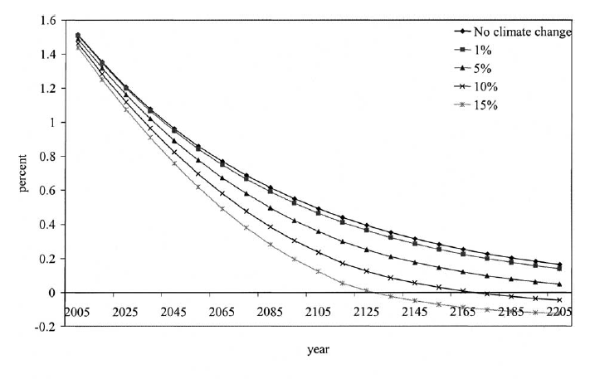

Slide 27
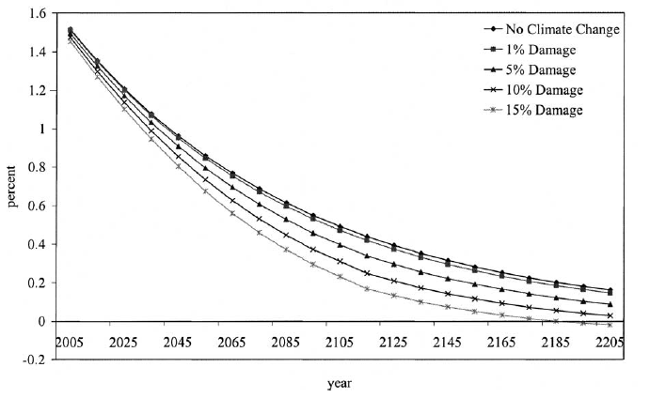

Slide 28
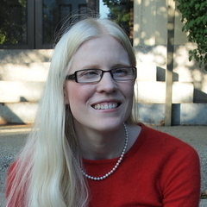
Dell, Jones, Olken, 2012, AEJ Macro

Slide 29
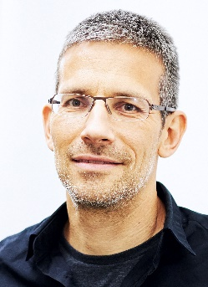
Barrios, Bertinelli, Strobl, 2010, REStat

Slide 30
Climate and Development
Recap of distribution of impacts
Dynamic vulnerability
Schelling Conjecture
Climate and growth
Climate and development

Slide 31
Climate and poverty
Cool countries tend to be rich, hot countries tend to be poor

Slide 32
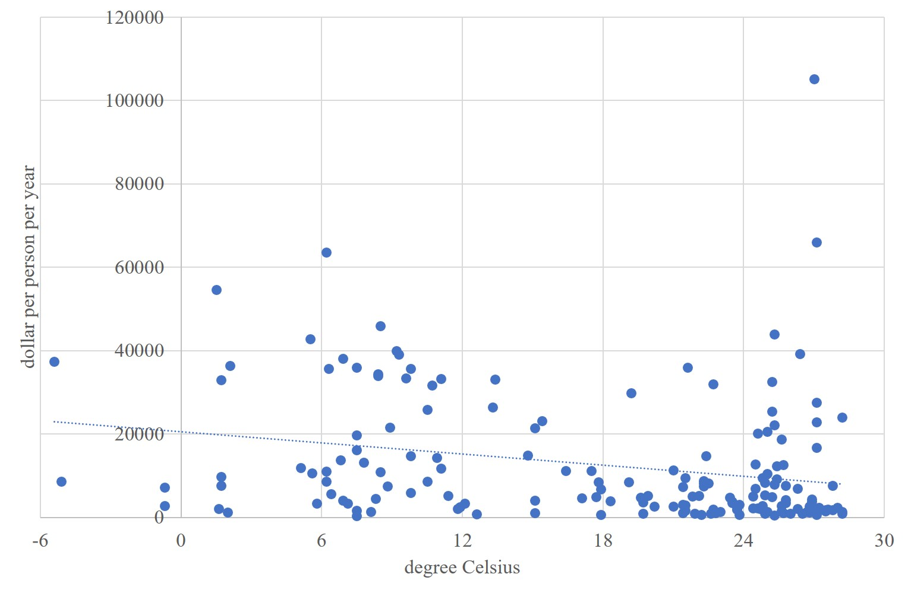
Cool countries tend to be rich, hot countries poor - 2000

Slide 33
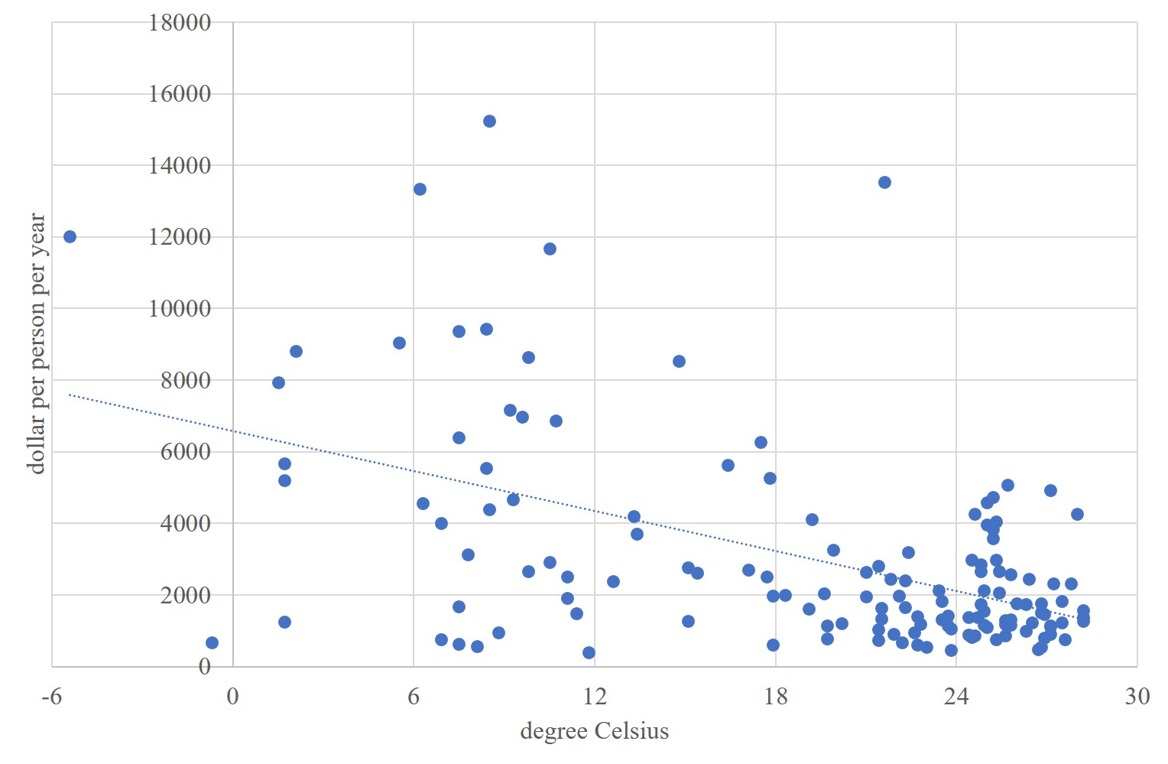
Cool countries tend to be rich, hot countries poor - 1950

Slide 34
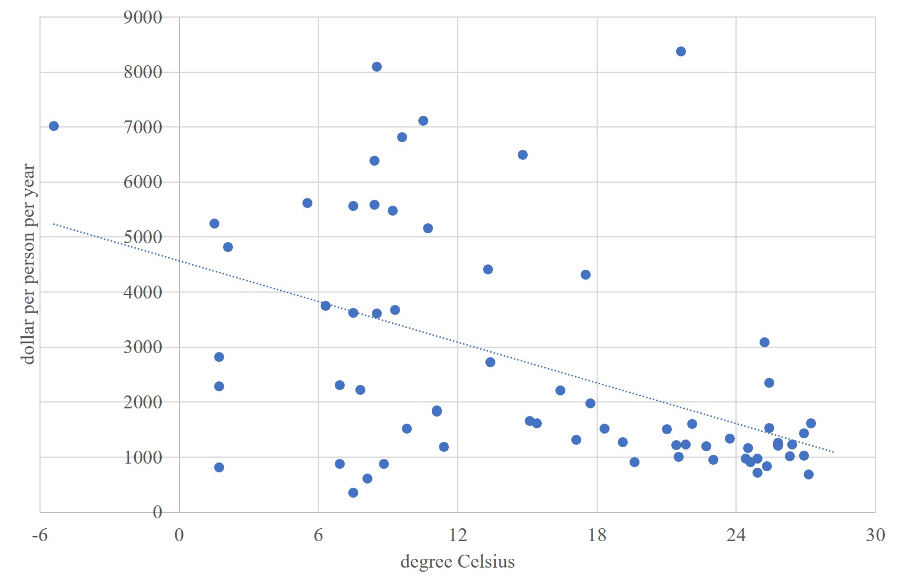
Cool countries tend to be rich, hot countries poor - 1913

Slide 35
Cool countries tend to be rich, hot countries poor - 1900

Slide 36
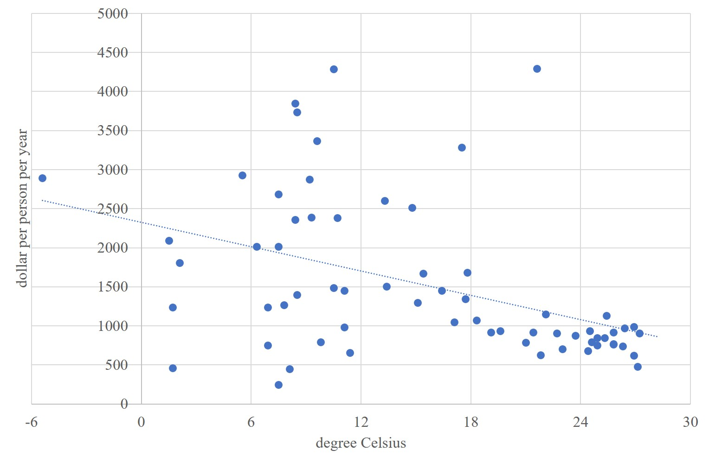
Cool countries tend to be rich, hot countries poor - 1870

Slide 37
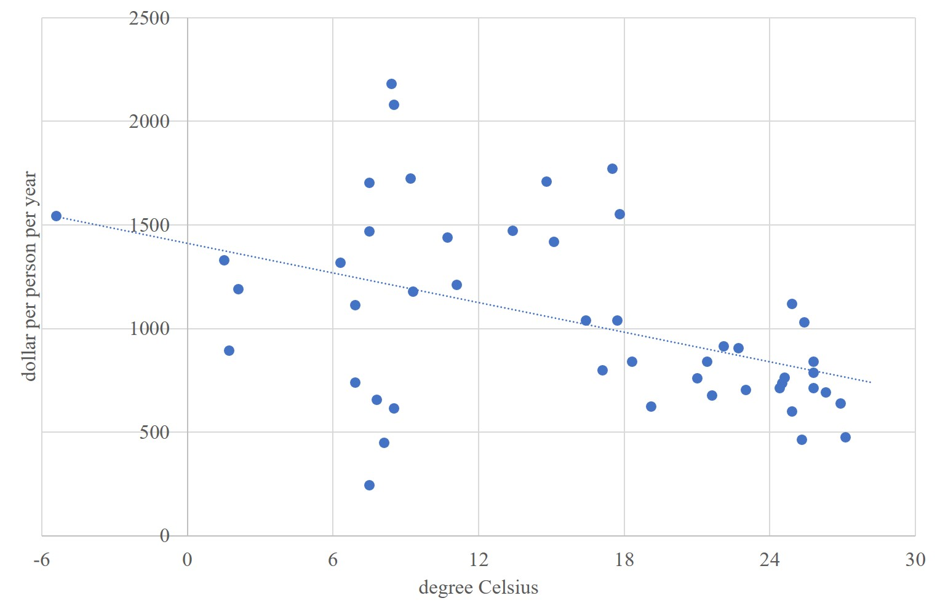
Cool countries tend to be rich, hot countries poor - 1820

Slide 38
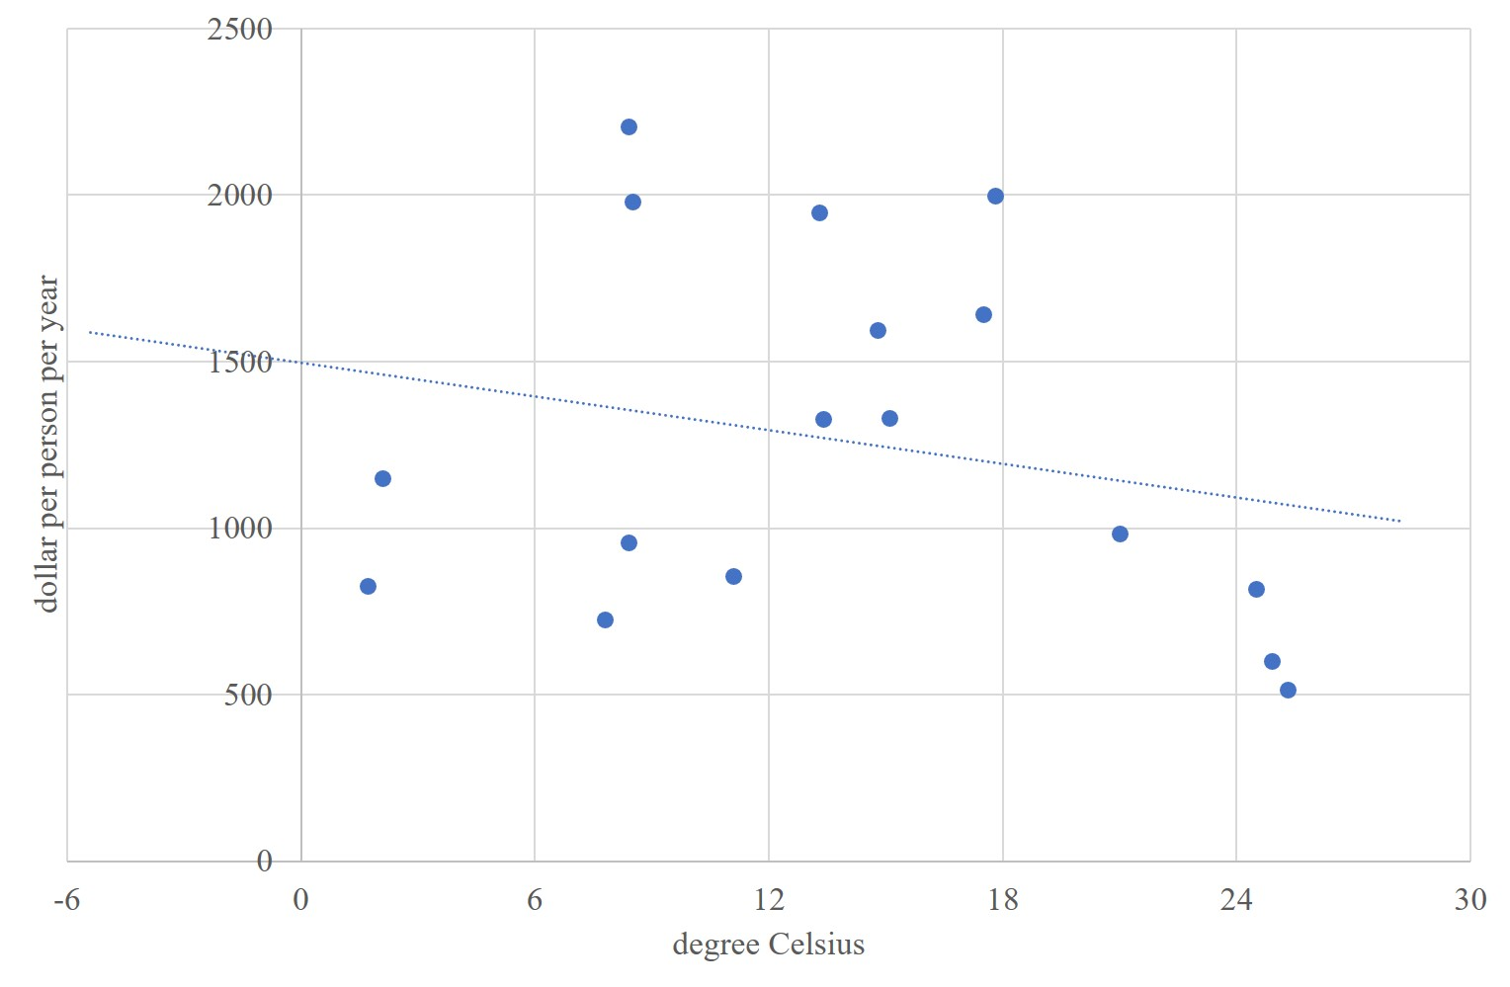
Cool countries tend to be rich, hot countries poor - 1800

Slide 39
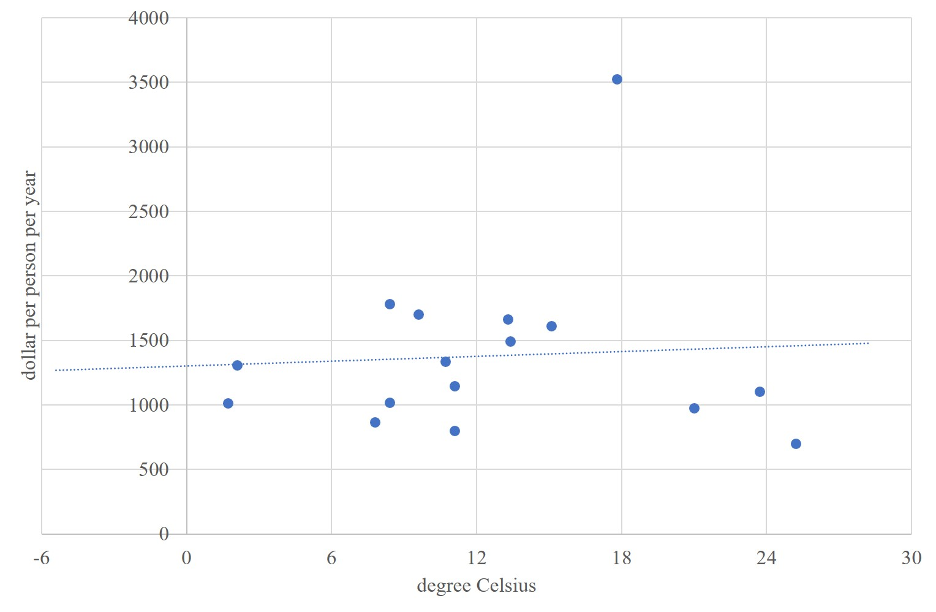
Cool countries tend to be poor, hot countries rich - 1750

Slide 40
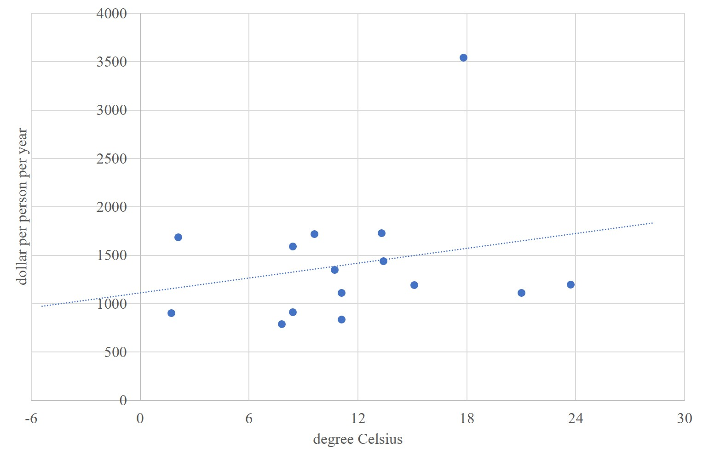
Cool countries tend to be poor, hot countries rich - 1700

Slide 41
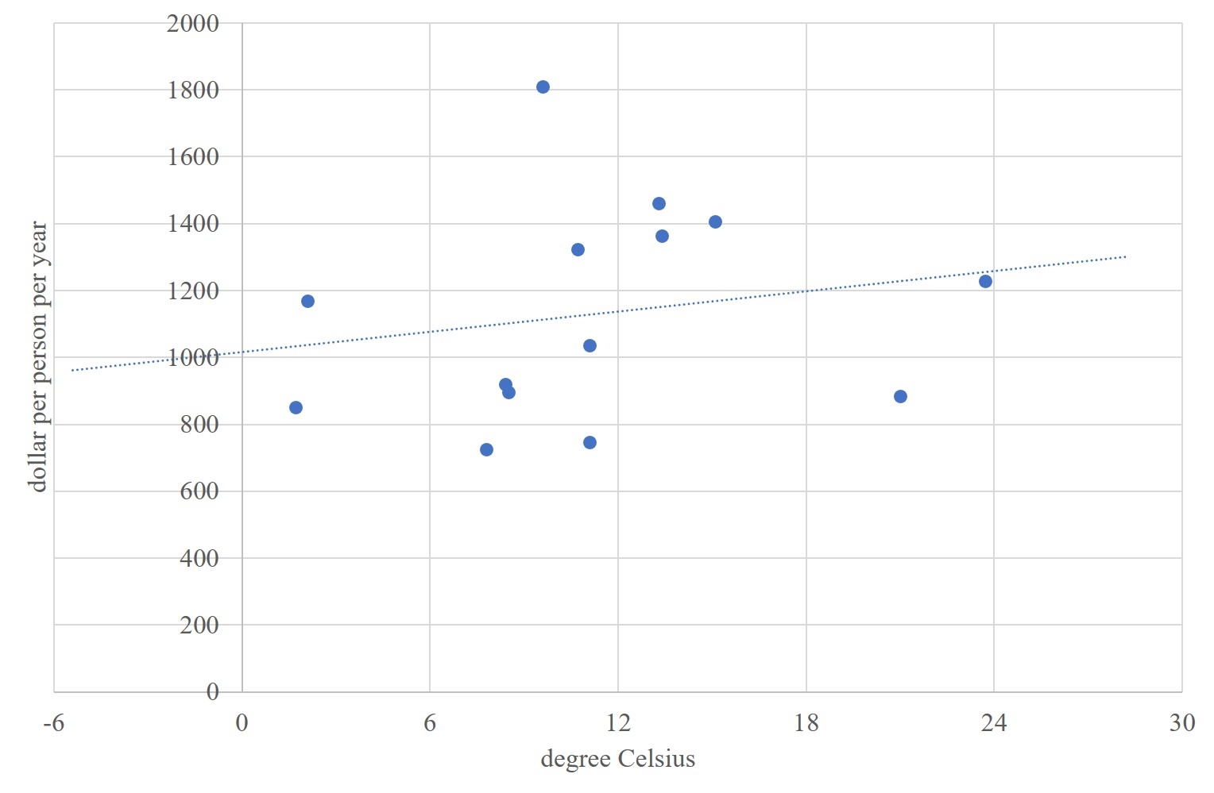
Cool countries tend to be poor, hot countries rich - 1650

Slide 42
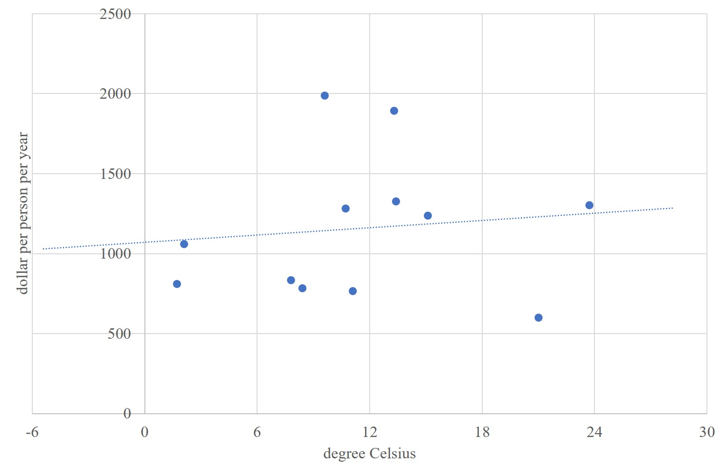
Cool countries tend to be poor, hot countries rich - 1600

Slide 43
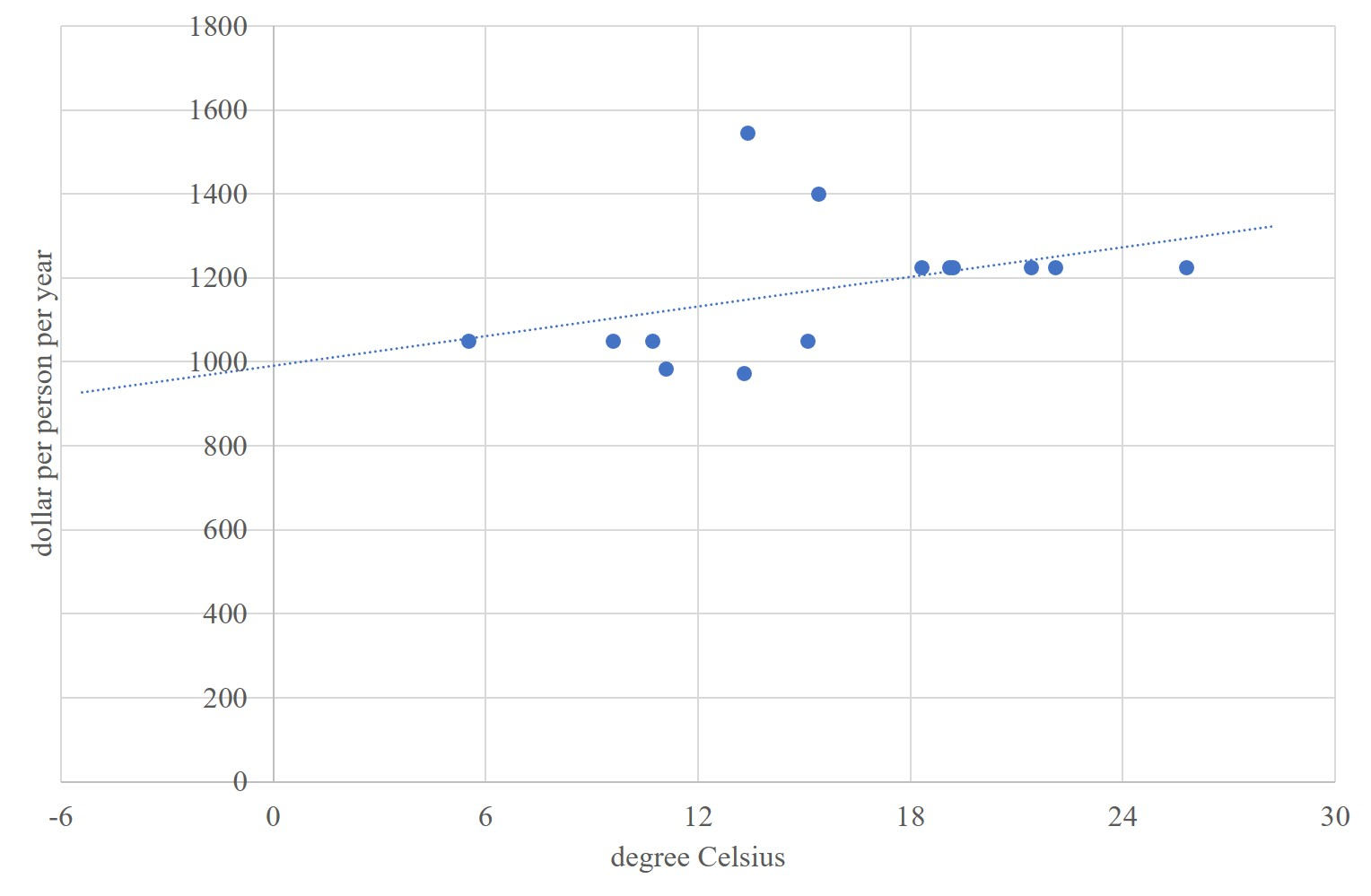
Cool countries tend to be poor, hot countries rich - 0

Slide 44
Climate and poverty
Cool countries tend to be rich, hot countries tend to be poor
Correlation sure, in recent centuries, but causation?

Slide 45
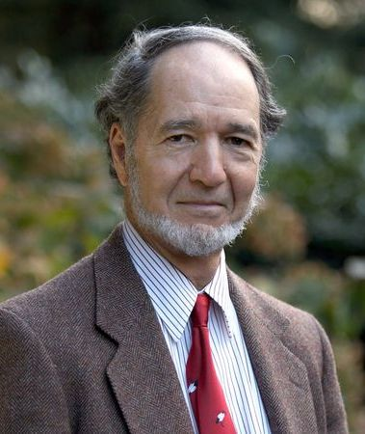
Climate and poverty
Cool countries tend to be rich, hot countries tend to be poor
Correlation sure, in recent centuries, but causation?
Diamond: Climate and geography are destiny

Slide 46
Olsson, Hibbs, 2005, EER

Slide 47
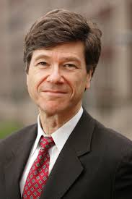
Climate and poverty
Cool countries tend to be rich, hot countries tend to be poor
Correlation sure, in recent centuries, but causation?
Diamond: Climate and geography are destiny
Sachs: Climate and geography are important

Slide 48
Gallup, Sachs, Mellinger, 1999, IRSR

Slide 49

Climate and poverty
Cool countries tend to be rich, hot countries tend to be poor
Correlation sure, in recent centuries, but causation?
Diamond: Climate and geography are destiny
Sachs: Climate and geography are important
Acemoglu: Climate and geography were important

Slide 50
Acemoglu, Johnson, Robinson, 2001, AER

Slide 51

Climate and poverty
Cool countries tend to be rich, hot countries tend to be poor
Correlation sure, in recent centuries, but causation?
Diamond: Climate and geography are destiny
Sachs: Climate and geography are important
Acemoglu, Easterly, Rodrik: Climate and geography helped to shape institutions, but nowadays institutions rule
Dalgaard: Adding subnational observation, climate is import
Johansson: It’s UV, actually, via blindness
Alsan: Tse-tse did it (in the past)

Slide 52
Poverty traps?
If infant mortality is high (and it is in hot and wet climes), parents would have many children to ensure that at least a few survive. Risk-average parents would have more children than they want. Parents could not afford health care and education. Children grow up to be poor too.
If there is a risk of losing it all (and there is in volatile climes), there is no point in saving for the future. A feast and famine culture gets engrained. Also steers investment in non-perishables, such as education.

Slide 53
Climate change and poverty
Climate change could intensify such mechanisms.
This would be an enormous welfare loss.
However, this is still speculative – and it clear that there is no ground for fatalism
Cultures change
Infectious disease is treatable and preventable

